Slide 1
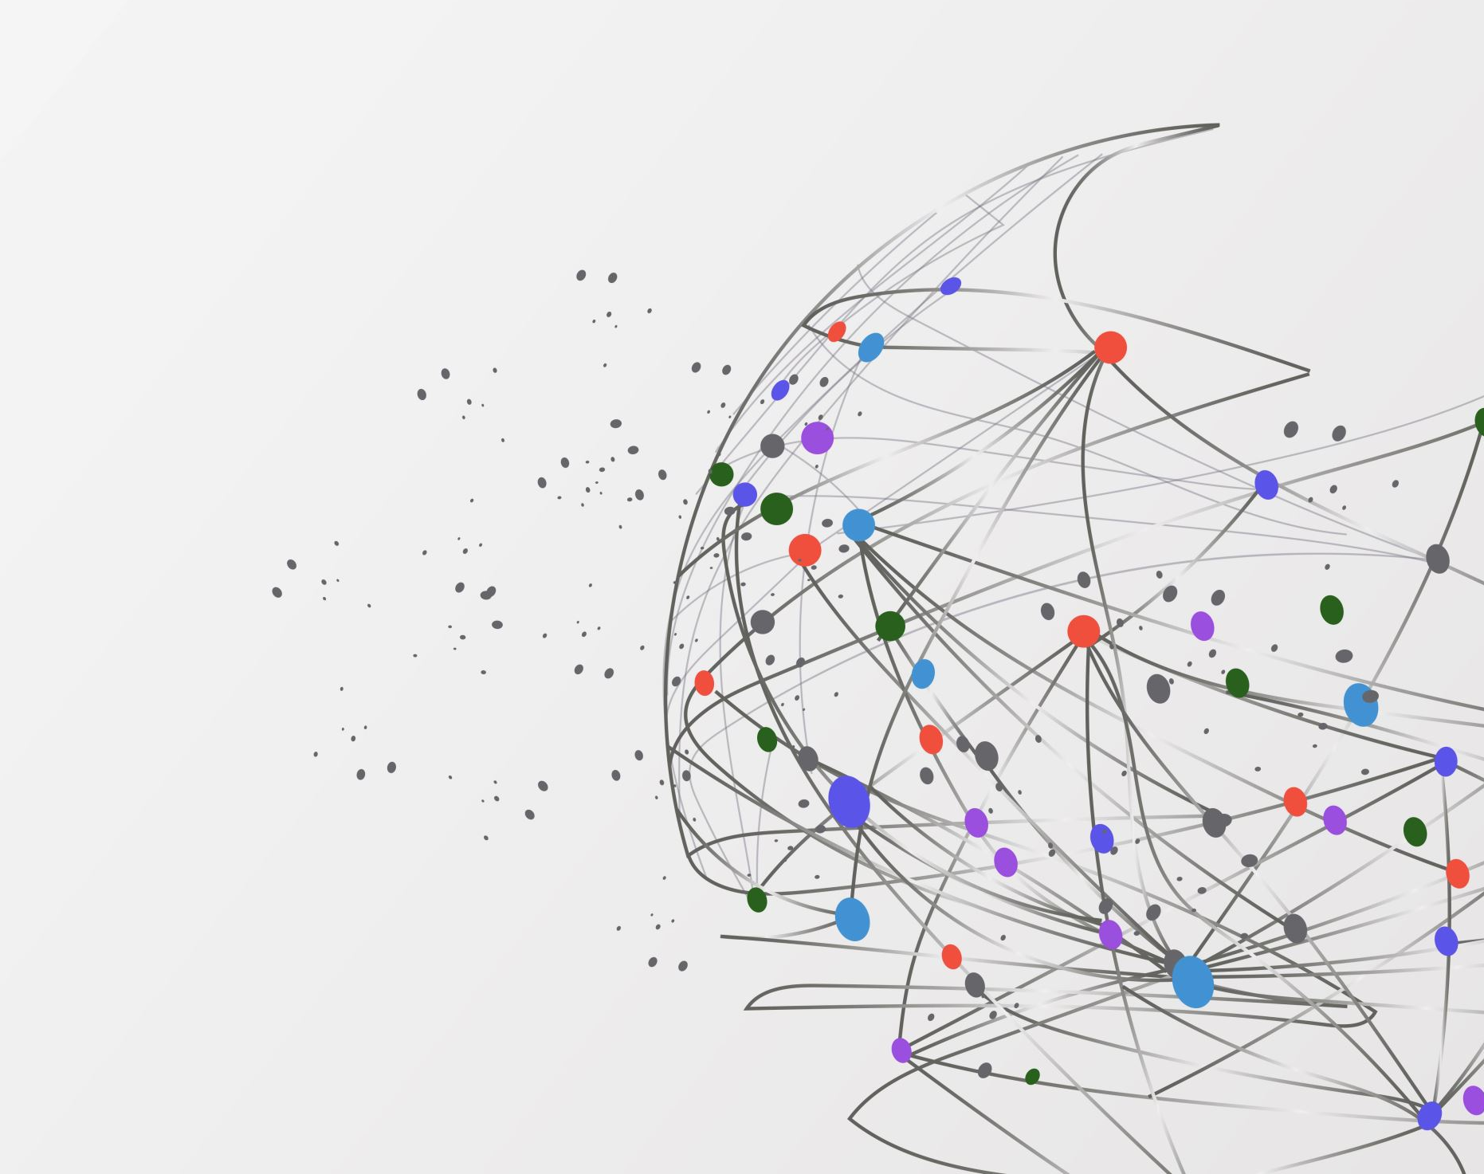
Brain Tumor Detection Using Federated Learning
-Muddasir I Attar
CSU ID: 836057300
-Rohini Chatterjee
CSU ID: 835696240

Slide 2
Introduction
Problem Statement
Technical Challenges
Approaches
Results
Broader Impact

Slide 3
Introduction
We are proposing a way to analyze Brain Tumor Detection from the MRI images and we have used federated learning to ensure data privacy for this approach.
federated Learning technology is developing as an effective remedy in such a dynamic environment. This model will help the doctors to accurately predict brain tumors in MRI images and it will also help to make the treatment faster along with privacy concern of patients.
It will help the Doctors to for faster decisions with keeping the privacy concern of the patients.
We have created a main model which is trained on a Brain tumor Datasets then we have shared the weights over the clients model.
Then we have trained the model with the data which the clients holds and we have taken the weights and taken the mean of all the weights and then we have it back to the main model.
As we are sharing the weights we are keeping the data private.

Slide 4
Problem Statement
Medical image data, including brain MRI scans, contain the subjects' personal information and cannot be shared or used without special authorization. This makes it challenging to analyze medical photos from many sites in an aggregated way.
A collaborative learning paradigm known as federated learning (FL) can create an objective global model by gathering updates from local models that have been trained using client data while maintaining the confidentiality of the client's local data.
This study uses Federated Learning to identify brain tumors from MRI images in order to address the problem of centralized data collecting.
We are proposing a way to analyze Brain Tumor Detection from the MRI images and we have used federated learning to ensure data privacy for this approach.

Slide 5
Technical Challenges
While designing the model on TenserFlow, we faced issues such as version mismatch.
Small amount of dataset.
Then not enough resources for Federated Learning are available on internet as it’s a relatively new topic.
Not getting better accuracy
Some federated models only work on specific versions of tensorflow.
Communication is a key bottleneck to consider when developing methods for federated networks. This is because Federated networks potentially include a massive number of devices (for example, millions of smartphones), and communication in the network can be slower than local computation by many orders of magnitude.

Slide 6
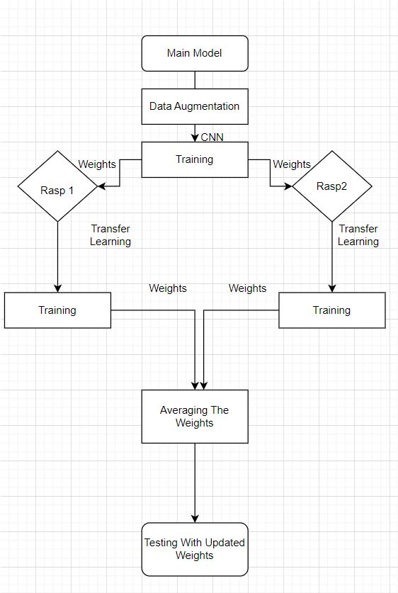
Approaches

Slide 7
Dataset
The dataset that we have used is Brain Tumor MRI dataset that is available on Kaggle.
The dataset uses 253 images of brain tumors as ‘yes’ and ‘no’ according to the presence or absence of the tumor.
It is split into 155 images for brain tumor and 98 images for no brain tumor. We split the data into 60% for the main model into training and validation and 20% for Raspberry Pi1 for training, testing and validation and 20% for Raspberry Pi2 for training, testing and validation.
Then, we created labels for main model and Raspberry Pi1 and 2 data. they were labeled as “0” and “1” according to the presence or absence of the tumor and saved them as csv files, namely, main_data, rasp1_data and rasp2_data as shown in Figures

Slide 8
Labeling and Data Augmentation
We have labeled data as ‘0’ for no tumor
We have labeled data as ‘1’ for yes tumor
We augmented the training data by flipping the image horizontally.
And rotating the image randomly by 20%

Slide 9
Raspberry Pi 1 and Raspberry Pi2
Transfer learning
Getting the weights from main model
Training Rasp1 and Rasp2 on unseen data
Setting the weights generated from Rasp1 and Rasp2
Checking the training accuracy over the main model

Slide 10
Averaging the weights and Testing.
We have taken the weights from rasp1 and rasp2.
Then taking average of those two model and creating a global model with updated weights
Using this global model updated weights testing the models on unseen data.

Slide 11

Results
Training accuracy for main model 88%
Training accuracy for rasp1 model 89%
Training accuracy for Rasp2 model 80%
Test accuracy for Rasp1 without updated global model is 80%
Test accuracy for Rasp1 with updated global model is 89%
Test accuracy for Rasp2 without updated global model is 80%
Test accuracy for Rasp2 with updated global model is 89%

Slide 12
Broader Impact
We can use the federated learning for different approaches such as Medical, smartphones, autonomous car, advertising, IoT.
We can use federated learning on data which user don’t wants to share.
User/client device might not have computation capacity.

